Slide 1

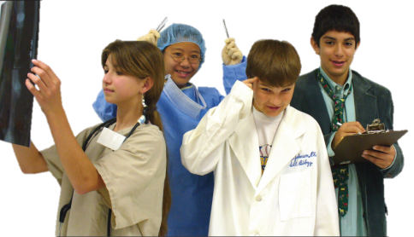
Online Microscope Images
Toolkit
Larry Johnson, PhD
Partnership for Environmental Education and Rural Health (PEER)
peer.tamu.edu
YouTube: VIBS Histology
Veterinary Integrative Biosciences
Texas A & M University
YouTube video of toolkit
http://www.youtube.com/vibshistology

Slide 2
Toolkit Contents
Operating Online Microscope Images
Cell Count
Cell/Tissue Volume Density
Percentages of Cells
Diameter of Cells
Organelle Volume Density

Slide 3
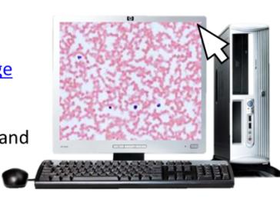
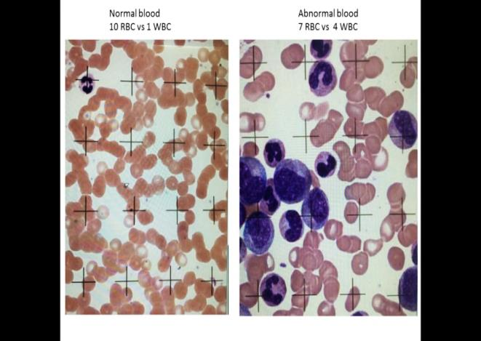
Why do cell counts (stereology)?
----------------------------------------------------------------------
Stereology (random independent sampling of the whole group as opposed to counting all individuals in that group) allows quantitative analyses of images, cells, tissues, or micrographs to supplement general observations. It tells you how much change occurred not just that a change has occurred. This might indicate how sick a person is, how successful a treatment might be, or whether a person is getting better or worse. It might be used to determine if an observed change is statistically significant.

Slide 4
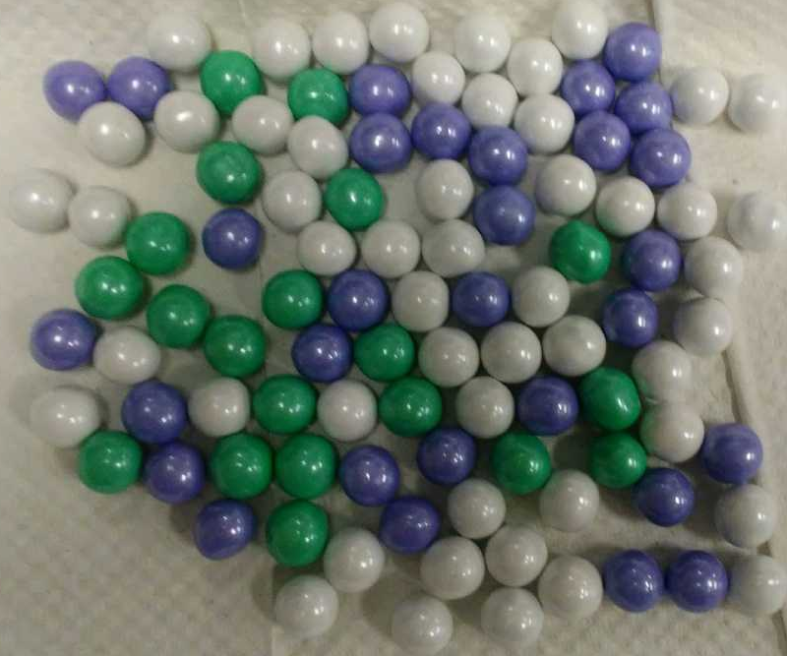

Slide 5
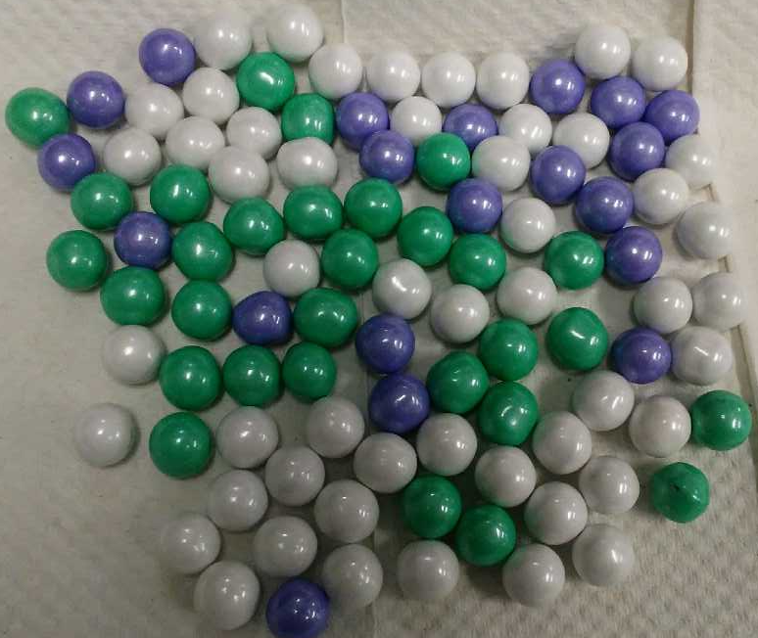

Slide 8
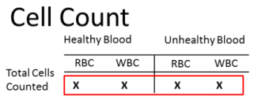
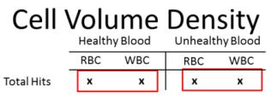
Why do stereology and integrate technology and math (STEM) in science?
---------------------------------------------------------------------------
Use of this toolkit gives students an opportunity to evaluate microscopic images where they interact with images of specimens (each student makes his/her own measurements) and use technology to do so as they integrate math and science. They see the value of and use math in scientific investigation to determine the amount of difference between samples. One might hypothesize that abnormal blood has 10 to 100 times the concentration of white blood cells as does the normal blood, but does the conclusion of the stereological analyses agree?
Calculations/
technology

Slide 9
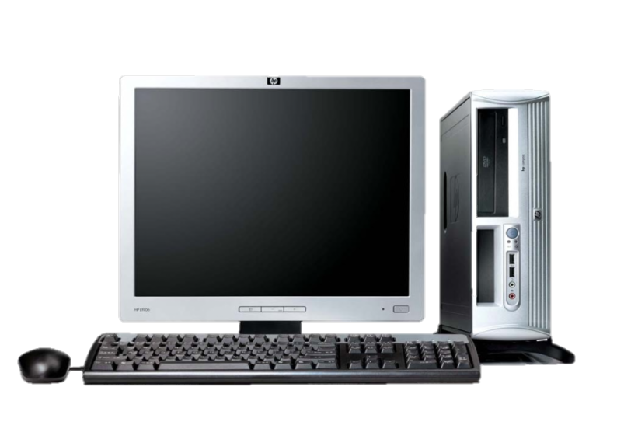
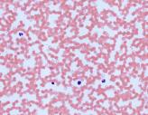
1. Operating Microscope Images
Online Microscope Image Links:
Healthy Blood Smear Image
Unhealthy Blood Smear Image
Human Testes Image
To move around the image, click and drag with the mouse to move to different parts of the image.
To move quickly to a completely new area, click at one corner and drag to the opposite corner.
Note: These images are taken from dead but preserved cells and tissues which were stained to allow observation and digitizing by light or electron microscopy.
Return to
Toolkit

Slide 10
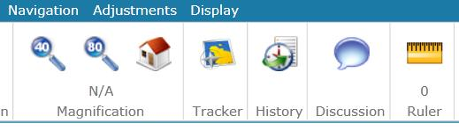

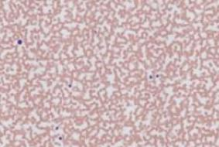
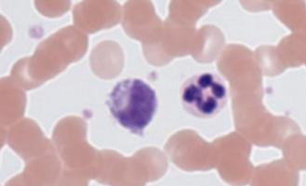
1. Operating Microscope Images
To change Magnification, click the magnifying glass icons at the top left tool bar or use the mouse scroll wheel. When scrolling, the different magnifications are indicated above the word “Magnification.”
5x
80x

Slide 11
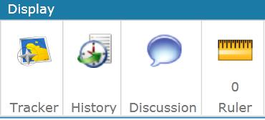
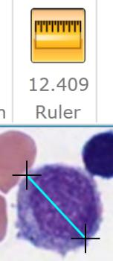
1. Operating Microscope Images
To turn on the Ruler tool, click on the ruler icon in the top toolbar.
Place your arrow on one side of the cell, click and drag your pointer to the other side, and click to measure a cell’s diameter.
Values are displayed beneath in micrometers (µm).
To turn off the ruler tool, click the ruler icon again.
Note, you must turn off the ruler to change magnification or move to a different area.

Slide 12
2. Cell Count Procedure
Print out the Box Counter on a transparency sheet.
Set the magnification to 80x.
Hold the Box Counter transparency over the computer screen. Tape it in place if need be.
Return to
Toolkit

Slide 13
2. Cell Count Procedure
Print out the Box Counter on a transparency sheet.
Set the magnification to 80x.
Hold the Box Counter transparency over the computer screen. Tape it in place if need be.
Students will do a separate count for red blood cells and white blood cells.
Count the number of cells inside each box, including ones touching the boxes borders to provide a random sampling that represents the whole.
Record the numbers in the worksheet and add up totals.
Print out the Box Counter on a transparency sheet.
Set the magnification to 80x.
Hold the Box Counter transparency over the computer screen. Tape it in place if need be.
Students will do a separate count for red blood cells and white blood cells.
Count the number of cells inside each box, including ones touching the boxes borders.
Record the numbers in the worksheet and add up totals.
Move to a new area and repeat two or more times.
Note: stacked overlapped red blood cells Regarding stacked overlapped blood cells in the abnormal blood sample, the best we can do is to count the curved lines (edges of cells) in a stacked group and an estimate here is required.

Slide 14
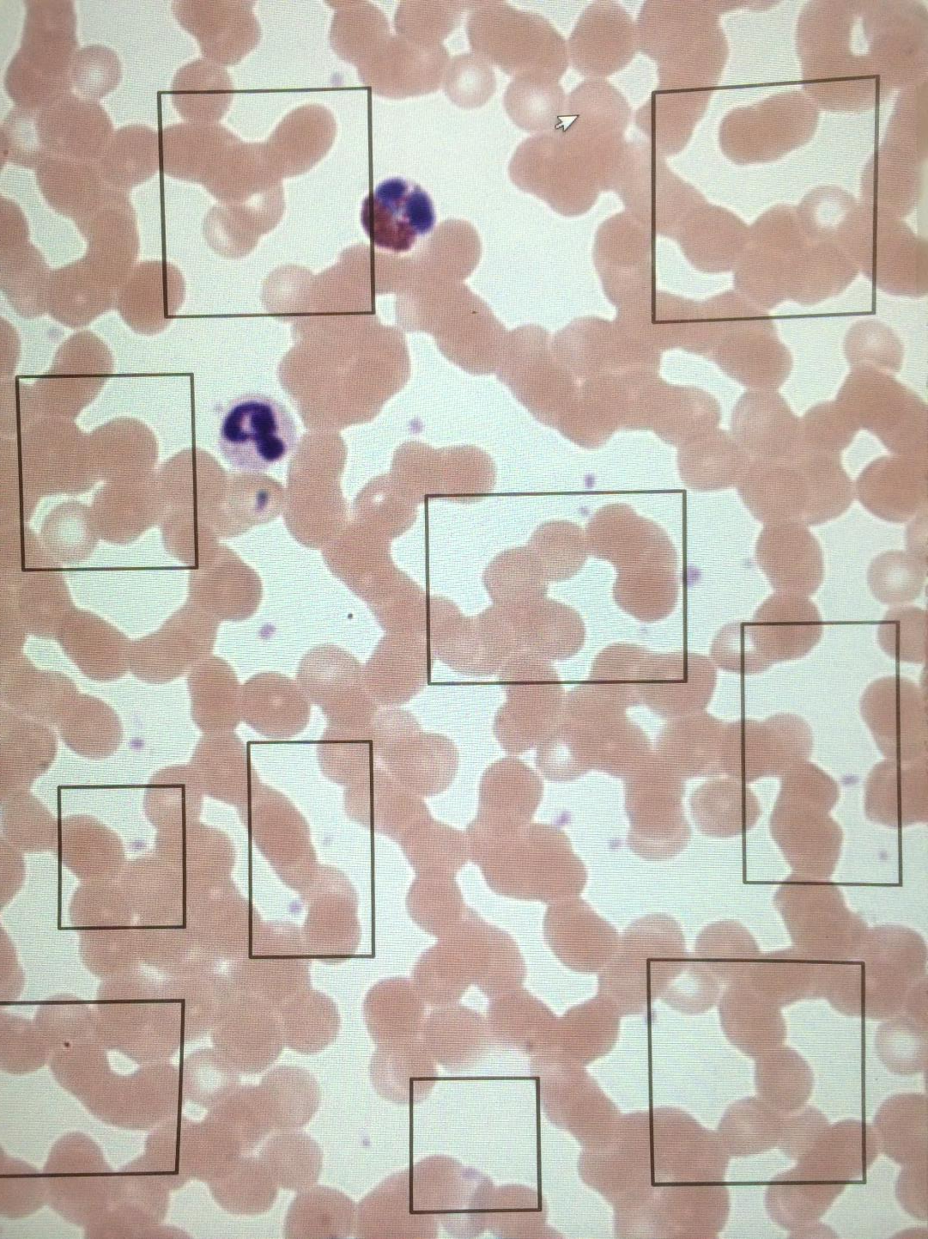
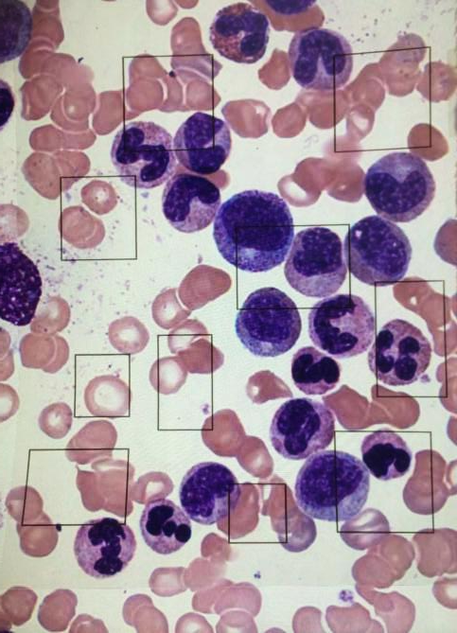
Normal blood
127 RBC vs 1 WBC
Abnormal blood
72 RBC vs 14 WBC

Slide 15
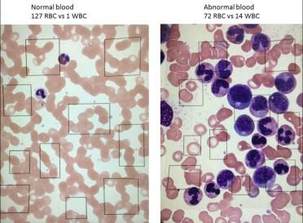
2. Cell Count - Example Data
Healthy Blood
Unhealthy Blood
RBC
WBC
RBC
WBC
28
15
25
23
30
…
...
40
0
1
0
0
1
…
...
1
8
15
5
14
8
…
...
6
10
7
6
4
5
…
...
5
Total Cells
Counted
2
62
633
237
= .003
62/
Ratio of cells
Magnitude of
difference
2/ 633
237 = .262
.262/ .003 = 87 times
Conclusion : white blood cells are 87 times more concentrated in the abnormal blood.

Slide 16
To determine the significance:
Finding the Ratios
Healthy Blood
Unhealthy Blood
RBC
WBC
Ratio
RBC
WBC
Ratio
15/1 = 15
17/1 = 17
21/1 = 21
21/1 = 21
21/2 = 10.5
19/1 = 19
103.5/6=
17.25
10/9 = 1.11
7/8 = 0.88
10/4 = 2.5
8/12 = 0.66
10/5 = 2.0
5/5 = +1
8.15/6=
1.36
These ratios compare number of times a RBC or a WBC was touched by the cross. If these numbers are added up and divided by the number of data collections (6) then the answer is the average, or MEAN
The MEAN of these numbers is used to find the standard deviation, or σ. The standard deviation measures how spread out the numbers are.

Slide 17
Finding the Variance
Healthy Blood
Unhealthy Blood
RBC
WBC
RBC
WBC
Standard Deviation is the square root of the VARIANCE. To find the variance, the mean is subtracted from each number, and the result is squared. Then find the mean of these numbers.
15/1 = 15
17/1 = 17
21/1 = 21
21/1 = 21
21/2 = 10.5
19/1 = +19
10/9 = 1.11
7/8 = 0.88
10/4 = 2.5
8/12 = 0.66
10/5 = 2.0
5/5 = +1
Mean
17.25
1.36
15 – 17.25 = -2.25² = 5.06
17 – 17.25 = -0.25² = 0.06
21 – 17.25 = 3.75² = 14.06
21 – 17.25 = 3.75² = 14.06
10.5 – 17.25 = -6.75² = 45.56
19 – 17.25 = 1.75² = 3.06
81.86/6=
13.64
1.11 – 1.36 = -0.25² = 0.06
0.88 – 1.36 = -0.48² = 0.23
2.50 – 1.36 = 1.14² = 1.30
0.66 – 1.36 = -0.70² = 0.49
2.0 – 1 .36 = 0.64² = 0.41
1.0 - 1.36 = -0.36² = 0.13
2.62/6=
0.44

Slide 18
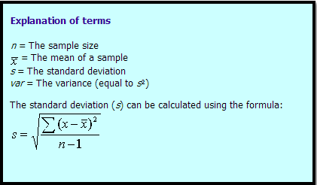
Finding the Standard Deviation
Standard Deviation is the square root of the VARIANCE.
Healthy Blood
Unhealthy Blood
RBC
WBC
RBC
WBC
15/1 = 15
17/1 = 17
21/1 = 21
21/1 = 21
21/2 = 10.5
19/1 = 19
10/9 = 1.11
7/8 = 0.88
10/4 = 2.5
8/12 = 0.66
10/5 = 2.0
5/5 = +1
Standard Deviation
√13.64 = 3.69
√0.44 = 0.66
Mean
17.25
1.36
Variance
13.64
0.44
Standard Deviation
3.69
0.66

Slide 19
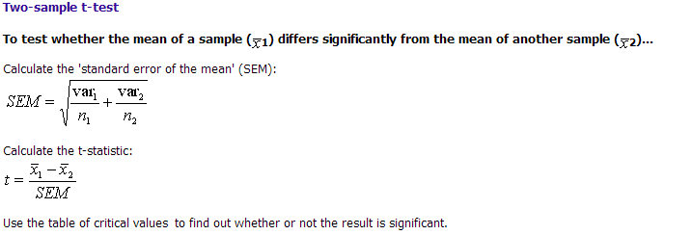


Doing a T Test
A T Test determines if the difference between two means is significant. This T Test will compare the means of the nuclei data in plant and animal cells.
13.64
0.44
1.53
6
6
17.25
1.36
10.39
1.53

Slide 20
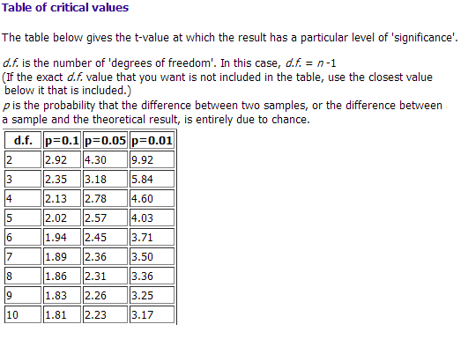
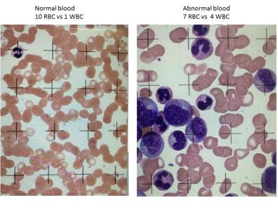



Doing a T Test
17.25
1.36
10.39
1.53
D.f. = 6-1 = 5
Since t = 10.39
10.39 > 4.03
Since 10.39 is greater than 4.03, the difference between the ratios of RBC to WBC in the normal and abnormal blood sample is significant at the p=0.01 level.

Slide 21
3. Cell Volume Density
Print out the Plus Counter on a transparency sheet.
Open the healthy blood image, and set the magnification to 80x.
Hold the Plus Counter transparency over the computer screen. Tape it in place if need be.
Return to
Toolkit

Slide 22
3. Cell Volume Density
Print out the Plus Counter on a transparency sheet.
Set the magnification to 80x.
Hold the Plus Counter transparency over the computer screen. Tape it in place if need be.
Count the number of cells under the center of each cross (one “hit” is scored for each cross) as a random sampling that represents the whole.
Record the numbers in the worksheet and add up totals.
Move to a new area and repeat hit count 5 or more times.
Add up the total hits that land on red blood cells from all repeated counts, divide by the number of possible “hits” (e.g., 5 repeats X 25 pluses per sheet = 125), and multiply that value by 100 to calculate cell volume density.
Repeat for white blood cells.

Slide 23
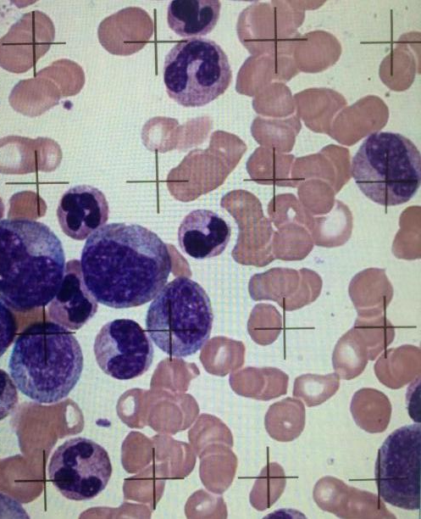
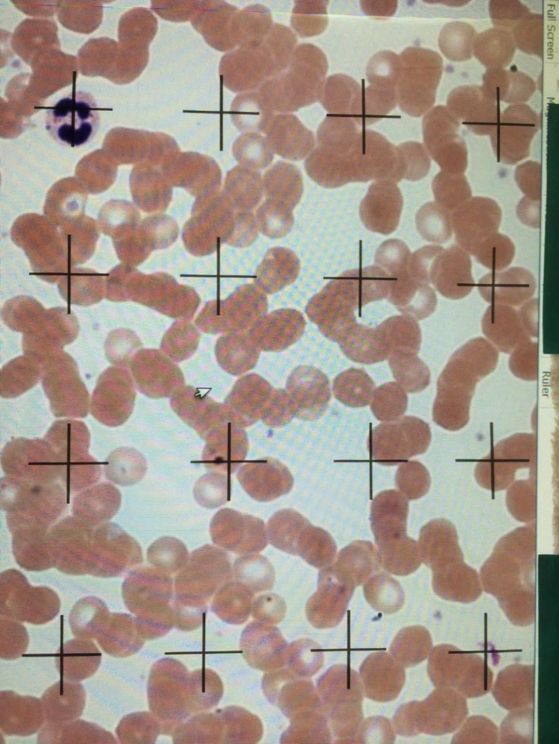
Normal blood
10 RBC vs 1 WBC
Abnormal blood
7 RBC vs 4 WBC
Note: To show cells at higher magnification, only 16 of the 25 crosses are shown here

Slide 24
3. Cell Volume Density Example Data
Healthy Blood
Unhealthy Blood
RBC
WBC
RBC
WBC
14
16
20
20
20
…
...
18
0
0
0
0
1
…
...
0
10
7
10
8
10
…
...
5
9
8
4
12
5
…
...
5
Total Hits
274
1
133
92
Ratio of cells
Magnitude of
difference
= .0036
1/ 274
92/133 = .6917
.6917/.0046 = 150 times
Conclusion : white blood cells occupy 150 times more volume in the abnormal blood.
Is this statistically significant?

Slide 25
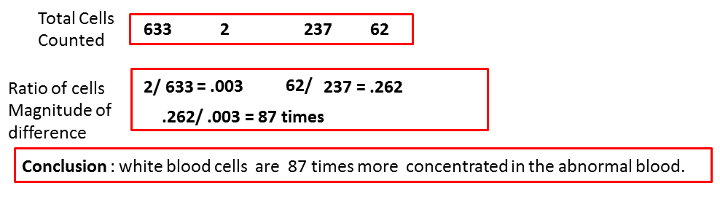
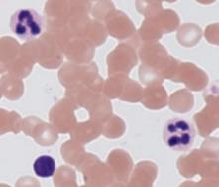
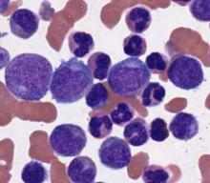
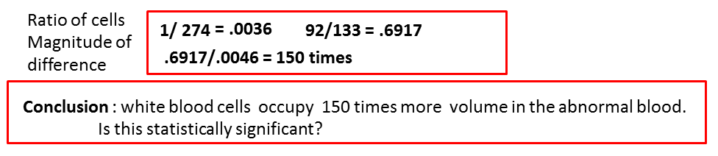
Do analyses from both the cell count (boxes) and volume density (crosses) conclude similar results (magnitude of difference)?
--------------------------------------------------------------
Conclusions: both methods indicated a larger ratio of white blood cells in abnormal blood; however, the greater magnitude of difference estimated by volume density indicates that the size of individual white blood cells were larger in the abnormal blood.

Slide 26
3. Cell Volume Density Example Data: percentage of whole occupied by each component
Healthy Blood
Unhealthy Blood
Total Hits
274
1
133
92
RBC
WBC
RBC
WBC
Total Cells Counted
274 + 1 = 275 133 + 92 = 225
Healthy Blood
Unhealthy Blood
RBC
RBC
Volume Density of Cells
274
133
x 100 =
99%
WBC
x 100 =
59%
275
225
WBC
1
92
x 100 =
0.36%
275
x 100 =
40%
225

Slide 27
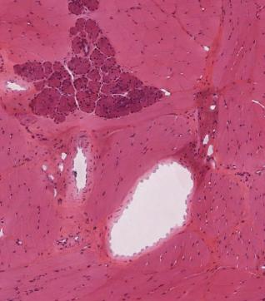
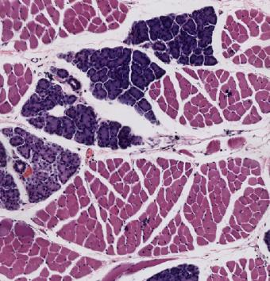
Comparing the Gland to Muscle ratio in the Monkey Tongue and the Rabbit Tongue
Monkey
Rabbit
Gland Cells
Gland Cells
Muscle Cells
Muscle Cells
There are both Glandular Cells and Muscle Cells in the tongue of both species.

Slide 28
Comparing the amount of Glandular Cells and Muscle Cells
By using the print out on the computer screen, you can get data about the ratio for glandular cells to muscle cells
Gland Cells
Gland Cells
Muscle Cells
Muscle Cells

Slide 29
To determine the significance:
Finding the Ratios
Monkey Tongue
Rabbit Tongue
gland
muscle
Ratio
gland
muscle
Ratio
4/67 = 0.06
4/66 = 0.06
3/72 = 0.04
4/67 = 0.06
3/70 = 0.04
0.26/5=
0.052
3/52 = 0.06
2/45 = 0.04
2/46 = 0.04
2/52 = 0.04
1/54 = 0.02
0.20/5=
0.04
These ratios compare number of times a Gland or a Muscle cell was touched by the cross. If these numbers are added up and divided by the number of data collections (5) then the answer is the average, or MEAN
The MEAN of these numbers is used to find the standard deviation, or σ. The standard deviation measures how spread out the numbers are.

Slide 30
Finding the Variance
Monkey Tongue
Rabbit Tongue
gland
muscle
Ratio
gland
muscle
Ratio
Standard Deviation is the square root of the VARIANCE. To find the variance, the mean is subtracted from each number, and the result is squared. Then find the mean of these numbers.
4/67 = 0.06
4/66 = 0.06
3/72 = 0.04
4/67 = 0.06
3/70 = 0.04
3/52 = 0.06
2/45 = 0.04
2/46 = 0.04
2/52 = 0.04
1/54 = 0.02
Mean
0.052
0.040
0.06 – 0.052 = 0.008² = 0.000064
0.06 – 0.052 = 0.008² = 0.000064
0.04 – 0.052 = -0.012² = 0.000144
0.06 – 0.052 = 0.008² = 0.000064
0.04 – 0.052 = -0.012² = 0.000144 =0.000544/5
0.0001088
0.06 – 0.040 = 0.02² = 0.0004
0.04 – 0.040 = 0.00² = 0.0000
0.04 – 0.040 = 0.00² = 0.0000
0.04 – 0.040 = 0.00² = 0.0000
0.02 – 0.040 = -0.02² = 0.0004
0.0008/5=
0.00016

Slide 31
Finding the Standard Deviation
Standard Deviation is the square root of the VARIANCE.
Monkey Tongue
Rabbit Tongue
gland
muscle
Ratio
gland
muscle
Ratio
5/20 = 0.25
2/22 = 0.09
7/14 = 0.50
3/20 = 0.15
2/22 = 0.09
5/13 = 0.38
8/7 = 1.14
9/7 = 1.29
10/7 = 1.43
6/11 = 0.55
Standard Deviation
√0.0001088 = 0.0104
√0.00016 = 0.0126
Mean
0.052
0.96
Variance
0.0001088
0.00016
Standard Deviation
0.0104
0.0126

Slide 32
Doing a T Test
A T Test determines if the difference between two means is significant. This T Test will compare the means of the nuclei data in plant and animal cells.
0.0001088
0.00016
0.0073
5
5
0.22
0.96
-2.55
0.29

Slide 33
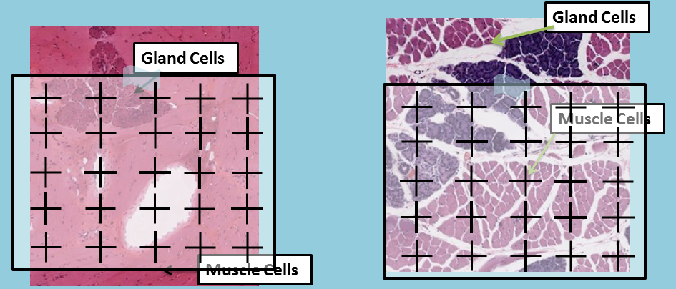
Doing a T Test
D.f. = 5-1 = 4
Since t = 2.55
2.13<2.55<2.78
Since 2.55 is less than the value for p=0.05, the difference is not statistically significant. However, since the value is greater than the value for p = 0.10, the test shows a trend.

Slide 34
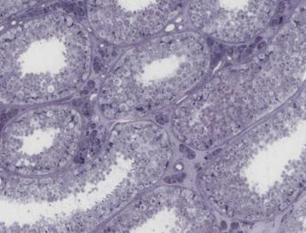
3. (Cont’d) Tissue Volume Density
Print out the Plus Counter on a transparency sheet.
Open the human testes online image to 10x magnification.
Hold the Plus Counter transparency over the computer screen. Tape it in place if need be.
Return to
Toolkit

Slide 35
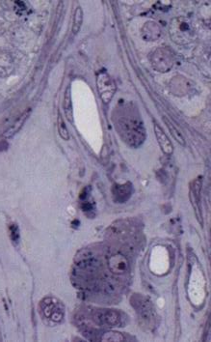
3. Tissue Volume Density
Print out the Plus Counter on a transparency sheet.
Set the magnification to 80x.
Hold the Plus Counter transparency over the computer screen. Tape it in place if need be.
Count the number of structures under the center of each cross (one “hit” is scored for each cross).
Structure will be either: Seminiferous Tubules, Boundary Tissue of Seminiferous Tubules, Leydig Cells, or Blood Vessels.
Record the numbers in the worksheet and add up totals.
Move to a new area and repeat hit count 4 or more times.
Add up the total hits that land on each structure from all repeated counts, divide by the number of possible “hits” (e.g., 5 repeats X 25 pluses per sheet = 125), and multiply that value by 100 to calculate tissue volume density.

Slide 36
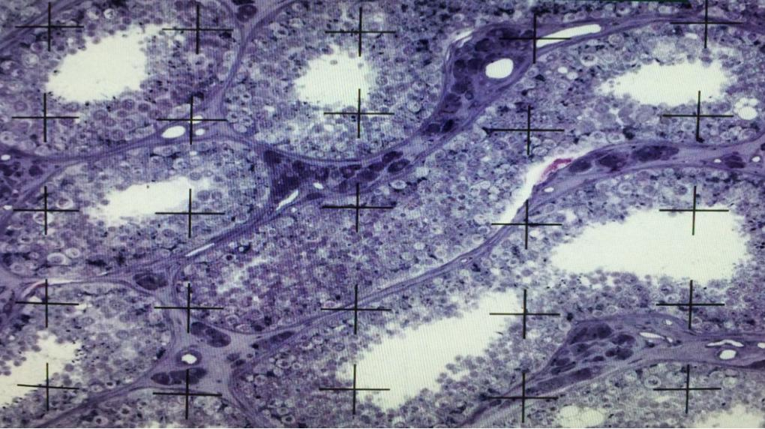
Human Testes (number of hits on structures)
21 Seminiferous Tubules, 2 Boundary Tissue, 2 Leydig Cells, and 1 Blood Vessel
Human Testes Image

Slide 37
3. Tissue Volume Density Example Data
Seminiferous Tubules
Boundary Tissue
Leydig Cells
Blood Vessels
21
21
20
21
21
3
3
2
3
3
3
2
3
2
3
0
0
0
1
0
Total Hits
104
14
13
1
Notes:
Pancreas to salivary gland- compare tissues.
Secretory cells, blood vessels, ducts and all other
Salivary probably more ducts.
Place image and count with a transparency
Compare skeletal and smooth at levels of the esophagus
More smooth muscle at distal levels, because the swallowing becomes involuntary
So compare the % and do a T test and such.
Compare skeletal and cardiac muscles
Compare nucleus v cytoplasm ratio between the two muscles
136- sk muscle
137- esophagus

Slide 38
3. Tissue Volume Density Example Data: percentage of whole occupied by each component
Seminiferous Tubules
Boundary Tissue
Leydig Cells
Blood Vessels
Total Hits
104
14
13
1
Possible Hits
5 counts x 25 pluses per sheet = 125
104
13
Volume Density of Tissue
x 100 =
83%
x 100 =
10%
125
125
14
1
x 100 =
11%
x 100 =
0.8%
125
125
Conclusion: The bulk of volume of testicular tissue is occupied by seminiferous tubules, Leydig cells and tubular boundary tissue contribute about 10% each, and a low volume of blood vessels.

Slide 39
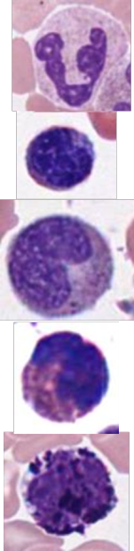
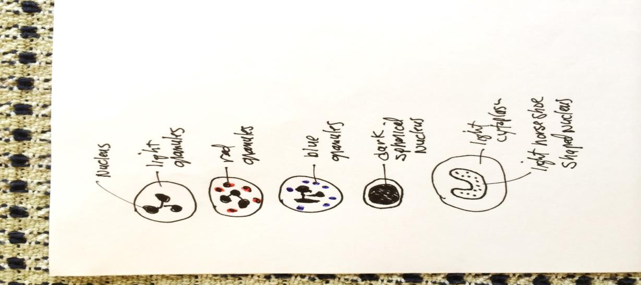
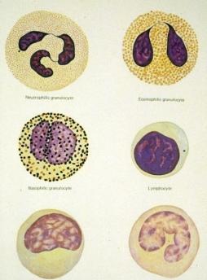
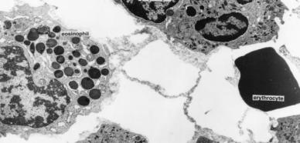
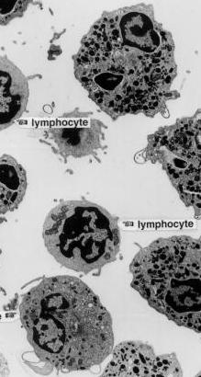
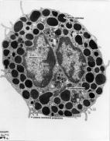

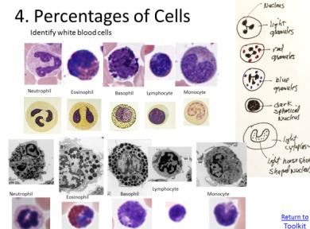

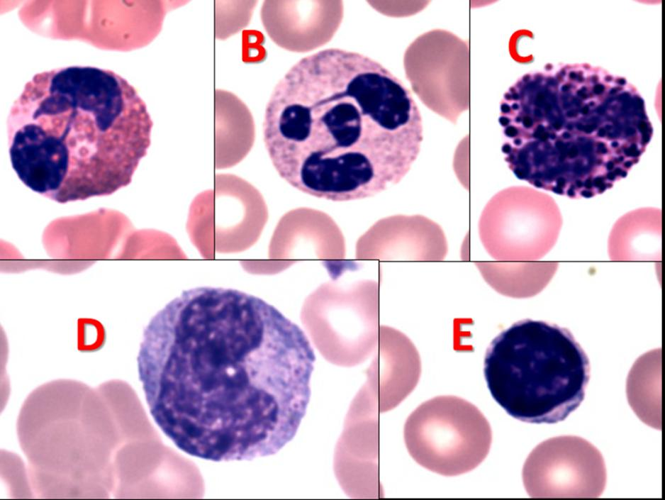
4. Percentages of Cells
Identify white blood cells
Neutrophil
Eosinophil
Neutrophil
Eosinophil
Basophil
Lymphocyte
Monocyte
Basophil
Lymphocyte
Monocyte
Lymphocyte
Monocyte
Neutrophil
Eosinophil
Basophil
Return to
Toolkit

Slide 40




Human blood cells and functions
Cell type Main functions
Erythrocyte CO₂ and O₂ transport
Neutrophil phagocytosis of bacteria
Eosinophil parasitic infections, inflammatory processes
Basophil release of histamine and other inflammation mediators
Monocyte Mononuclear-phagocyte system become macrophages

Slide 41
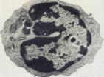
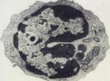
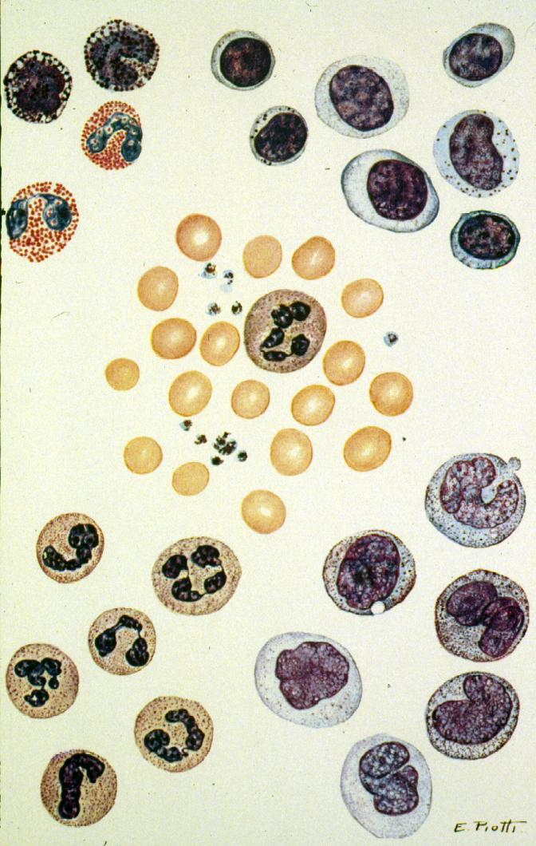
Human blood cells and functions con’t
Cell type main functions
B lymphocytes generation of antibody-producing plasma cells
T lymphocytes killing of virus-infected cells
Natural killer killing of some tumor and
(cytotoxic T cell) virus-infected cells
Platelets clotting of blood

Slide 42
Eosinophil
Neutrophil
Basophil
Lymphocyte
Monocyte

Slide 43

4. Percentages of Cells
Neutrophil
Eosinophil
Open the healthy blood image, and set the magnification to 80x.
Pick at least 50 random white blood cells and classify which type it is based on images below.
Calculate the percentage of each WBC type found in the sample.
Note, some WBC types are rare and you might not
find any of them (e.g., basophils).
Basophil
Lymphocyte
Monocyte
Return to
Toolkit

Slide 44
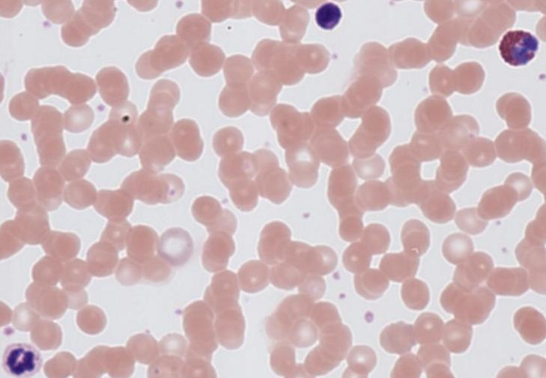


4. Percentages of Cells Example Data
Number of Cells in Healthy Blood
Neutrophil
Lymphocyte
Monocyte
Eosinophil
Basophil
Counted
46
8
6
2
1
Total
46 + 8 + 6 + 2 + 1 = 63
6
1
46
x 100 =
9%
63
x 100 =
Percent
x 100 =
73%
63
63
8
2
1%
63
x 100 =
12%
x 100 =
3%
63
Conclusion : Neutrophils are the most numerous white blood cell in blood.
Neutrophil

Slide 45
5. Diameter of Cells (Each white blood cell type)
Open the healthy blood image, and set the magnification to 80x.
Click on the ruler icon in the top toolbar to turn on ruler.
Place your arrow on one side of the cell, click and drag your pointer to the other side, and click to measure a cell’s diameter.
Values are displayed beneath in micrometers (µm).
Record the values of 25 RBCs cells and 25 of each WBCs.
Calculate the average size of each cell.
Return to
Toolkit

Slide 46
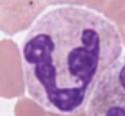

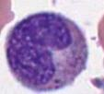

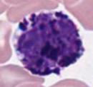
White blood cells
5. Diameter of Cells
To turn off the ruler tool, click the ruler icon again.
You must turn off the ruler to change magnification or move to a different area.
Some white blood cells are rare, try to find and measure at least five eosinophils, basophils, and monocytes.
Return to
Toolkit

Slide 47
5. Diameter of Cells Example Data
Healthy Blood
Measured in micrometers (µm).
RBC
Neutrophil
Lymphocyte
Monocyte
Eosinophil
Basophil
7.0
7.5
8.3
7.1
6.6
…
...
7.1
8.78
9.76
10.12
9.89
10.06
…
...
8.58
8.3
7.94
6.8
6.99
7.09
…
...
6.85
10.62
10.64
11.09
11.65
10.42
…
...
12.59
9.03
10.1
9.83
10.49
9.92
…
...
9.25
10.85
9.71
10.06
7.95
11.31
…
...
7.89
Average Size
7.36
9.38
7.31
10.51
9.64
9.63
Conclusion: Blood cells vary in size (diameters) with the monocyte being largest with RBCs and lymphocytes being smallest.

Slide 48
Size of human blood cells
Cell/platelet size
1. Erythrocytes 6.5-8 µm
2. Leukocytes (WBC) % of WBC
a) Neutrophil 12-15 µm 60-70%
b) Eosinophil 12-15 µm 2-4%
c) Basophil 12-15 µm 0-1%
d) Lymphocyte 6-18 µm
25%
e) Monocyte 12-20 µm
5%
3. Platelets 2-4 µm

Slide 49
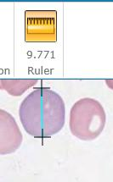
5. Diameter of Cells (continued)
(Mature red blood cells and immature reticulocytes)
Open the unhealthy blood image, and set the magnification to 80x.
Click on the ruler icon in the top toolbar to turn on ruler.
Place your arrow on one side of the cell, click and drag your pointer to the other side, and click to measure a cell’s diameter.
Values are displayed beneath in micrometers (µm).
Record the values of 25 or more RBCs cells and 25 or reticulocytes (blue, immature red blood cells).
Calculate the average size of each cell.
um
Return to
Toolkit

Slide 50
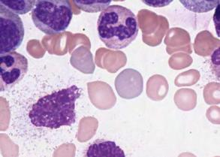

Unhealthy Blood
5. Diameter of Cells
Damaged
cell
To turn off the ruler tool, click the ruler icon again.
You must turn off the ruler to change magnification or move to a different area.
It is more difficult to distinguish reticulocytes from red blood cells in the healthy specimen and the volume density is much lower in the health specimen. They may be too hard to find.
reticulocytes and red blood cells
Healthy Blood
Return to
Toolkit

Slide 51
5. Diameter of Cells Example Data
Measured in micrometers (µm).
Healthy Blood
Unhealthy Blood
RBC
Reticulocyte
RBC
Reticulocyte
7.24
8.28
7.95
6.23
6.20
…
...
5.92
7.66
7.63
8.02
9.00
7.96
…
...
7.34
7.0
7.5
8.3
7.1
6.63
…
...
7.12
8.66
9.55
7.9
8.5
8.31
…
...
7.91
Average Size (µm)
6.97 7.93
7.36 8.46
Conclusion: Reticulocytes are larger than RBCs for both the normal and abnormal blood samples. The reticulocytes were larger in unhealthy than healthy blood.

Slide 52

6. Organelle Volume Density
Print out the Plus Counter on a transparency sheet.
Open the electron micrograph to full screen.
Hold the Plus Counter transparency over the computer screen. Tape it in place if need be.
nucleus
granules
Return to
Toolkit

Slide 53

6. Organelle Volume Density
Print out the Plus Counter on a transparency sheet.
Set the magnification to 80x.
Hold the Plus Counter transparency over the computer screen. Tape it in place if need be.
Count the number of organelles under the center of each cross (one “hit” is scored for each cross).
Count the number of crosses that touch nothing outside of the cell – this will be your possible hits total.
Rotate cross transparency 45 degrees to the right and recount. Rotate another 45 and repeat 1-3 more times.
Print out the Plus Counter on a transparency sheet.
Set the magnification to 80x.
Hold the Plus Counter transparency over the computer screen. Tape it in place if need be.
Count the number of organelles under the center of each cross (one “hit” is scored for each cross).
Count the number of crosses that touch nothing outside of the cell – this will be your possible hits total.
Rotate cross transparency 45 degrees to the right and recount. Rotate another 45 and repeat 1-3 more times.
Add up the total hits that land on each organelle from all repeated counts, divide by the number of possible “hits,” and multiply that value by 100 to calculate volume density.

Slide 54
6. Organelle Volume Density –
Example Data
Electron micrograph
Nucleus
Granules
Other
Total Possible
12
10
15
Total Hits
9 22 6 37
Organelle
Volume Density
9
22
6
x 100 =
24%
x 100 =
59%
x 100 =
16%
37
37
37
Conclusion: One forth of this cell was nucleus and 60% of this cell was granules.

Slide 55








Other electron micrographs that could be enlarged to fill the computer screen and be used to determine the volume density of organelles in different types of animal cells.

Slide 56
Toolkit Contents
Operating Online Microscope Images
Cell Count
Cell/Tissue Volume Density
Percentages of Cells
Diameter of Cells
Organelle Volume Density

Slide 57




Slide 58
Conclusion
----------------------------------------------------------------------
Stereology allows quantitative analyses of images, cells, tissues, or micrographs.
It might be used to determine if an observed change is statistically significant.

Slide 59

The end of

Slide 60
Link to transparencies
http://peer.tamu.edu/drop_box/Cell%20counter%20Transparency.docx

